Slide 1
Programming with Concurrency and Multithreading (in Java)
Week 01: Practical
HNDIT2411: Enterprise Architecture
Chapter 03

Slide 2
Example: Runnable interface
Public class PrintRunnableThread implements Runnable {
public static void main(String[] args) {
Thread t = new Thread(new PrintRunnableThread());
t.start();
while(true) { System.out.println(“main”); }
}
public void run() {
while( true ) { System.out.println( “Thread” ); }
}
}

Slide 3
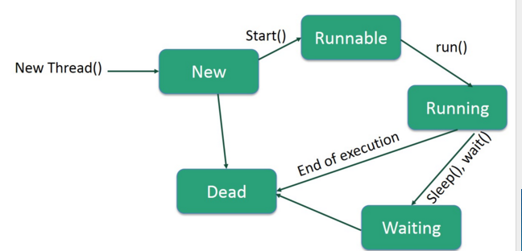

Slide 4
Controlling Threads
Thread.sleep() method puts the current
running thread to pause execution
sleep( long milliseconds )
sleep( long ms, long ns )
A thread that is sleeping can be interrupted, so
you must handle a InterruptedException if
you put a thread to sleep
try {
Thread.sleep( 5000 )
} catch( InterruptedException ie ) {
System.out.println( “Interrupted” );
}

Slide 5
What happens to new threads?
Main thread continues
New threads execute the run method and die
when they are finished
If any thread calls System.exit(0), it will kill all
threads.
Think of each run() as its own main
Program does not exit until all non-daemon
threads die.

Slide 6
Controlling Threads
Thread.yield()method allows other
threads a chance to execute.
The JVM thread scheduler is generally
fair, but in intensive operations a
thread can monopolize. Adding in a
random chance of yielding can improve
fairness.

Slide 7
Thread Ops
isAlive() - Tests if this thread is alive. A thread is
alive if it has been started and has not yet died.
join() - Waits for this thread to die.
Thread.activeCount() - returns number of
active threads
Thread.enumerate() - fills an array with the
currently active threads
Thread.currentThread() - returns the current
thread
Thread.dumpStack() - useful for debugging

Slide 8
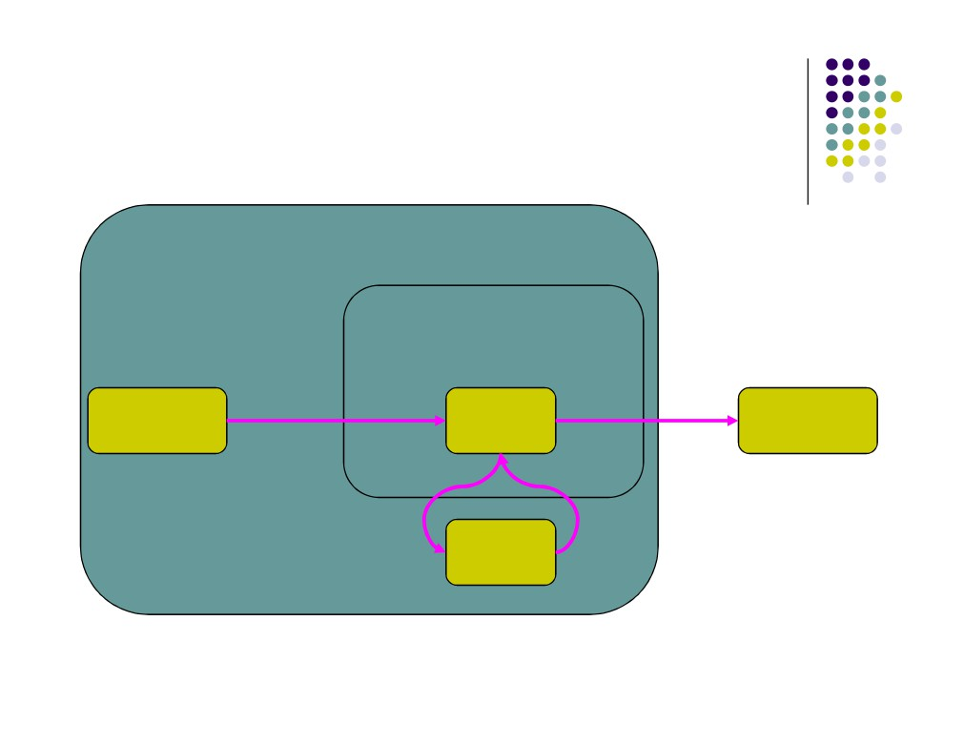
Thread State Diagram
Alive
Running
new CounterThread();
while (…) { … }
Dead Thread
run() method returns
New Thread
Thread.start();
Runnable
Object.wait()
Thread.sleep()
blocking IO call
Blocked
waiting on a monitor

Slide 9
Thread Scheduling
Execution of multiple threads on a single CPU in
some order is called scheduling.
The JRE uses fixed-priority scheduling which schedules
threads on the basis of their priority.
Thread priorities in the range Thread.MIN_PRIORITY and
Thread.MAX_PRIORITY
The chosen thread runs until one of the following conditions is
true:
A higher-priority thread becomes runnable.
The thread yields, or its run method exits.
On systems that support time-slicing, the thread's time
allotment has expired.

Slide 10
Thread Scheduling
Unlike most aspects of Java, Threading does not act
the same on different platforms. Two areas of
difference are Thread scheduling and Thread
priorities. The two approaches to scheduling are
Preemptive
Time slicing
If at any time a thread with a higher priority than all
other Runnable threads becomes Runnable, the
runtime system chooses the new higher-priority
thread for execution. The new thread is said to
preempt the other threads.
thread-scheduling algorithm is preemptive
A thread created from another thread inherits its
priority from the parent thread
Thread.setPriority( int priority )

Slide 11
Example 01
Try the following program out.
Try to understand what happen there.
class Thread01 extends Thread {
int threadID;
public Thread01(int a){
threadID = a;
}
public static void main(String args[]) {
for (int i=1; i<6; i++) {
Thread t = new Thread01(i);
System.out.println("Thread "+i+" created");
t.start();
System.out.println("Thread "+i+" started");
}
System.out.println("Main Thread exit");
}
public void run() {
while(true) {
System.out.println("Thread "+threadID+" running");
try
{
Thread.sleep((int)(10000*Math.random()));
}
catch (InterruptedException e){
} } } }

Slide 12
Example 01 ….
The above program create 6 threads. Main Thread and 5 child threads.
When we run the program Main Thread will be created and Main Thread execute the main() method.
Main thread go through a for loop with 5 iterations.
In each iteration Main Thread create a child thread and start it. (create 5 child threads)
Then Main Thread terminate.
Each child Thread executes run() method.
Each child Thread sleep for a random time between 0 and 10 seconds and print that they are running and go to sleep again

Slide 13
Example 02
Try the following program out.
Try to understand what happen there.
public class Thread02 implements Runnable {
public static void main(String[] args) {
Thread t = new Thread(new Thread02());
t.start();
while(true) {
System.out.println(“Main Thread");
try {
Thread.sleep((int)(10000*Math.random()));
}
catch (InterruptedException e){}
}
}

Slide 14
Example 02 ….
public void run() {
while( true ) {
System.out.println( “Child Thread" );
try
{
Thread.sleep((int)(10000*Math.random()));
}
catch (InterruptedException e){}
}
}
}

Slide 15
Example 02 ….
The above program create 2 threads (Main Thread and a child Thread).
Main Thread execute the main() method.
Main Thread create a child Thread and start it.
Then Main thread goes to a never ending loop.
Within the loop Main thread display a message and goes to sleep for a time duration between 0 and 10 seconds.
Child thread executes run() method.
Child thread also goes to a never ending loop.
Within the loop child thread display a message and goes to sleep for a time duration between 0 and 10 seconds.

Slide 16
Example 01 & 02
Example 01 and 02 create thread using 2 ways.
Example 01 extends Thread class and override run() method to create threads.
Example 02 implements Runnable Interface and implements the run() method to create threads.

Slide 17
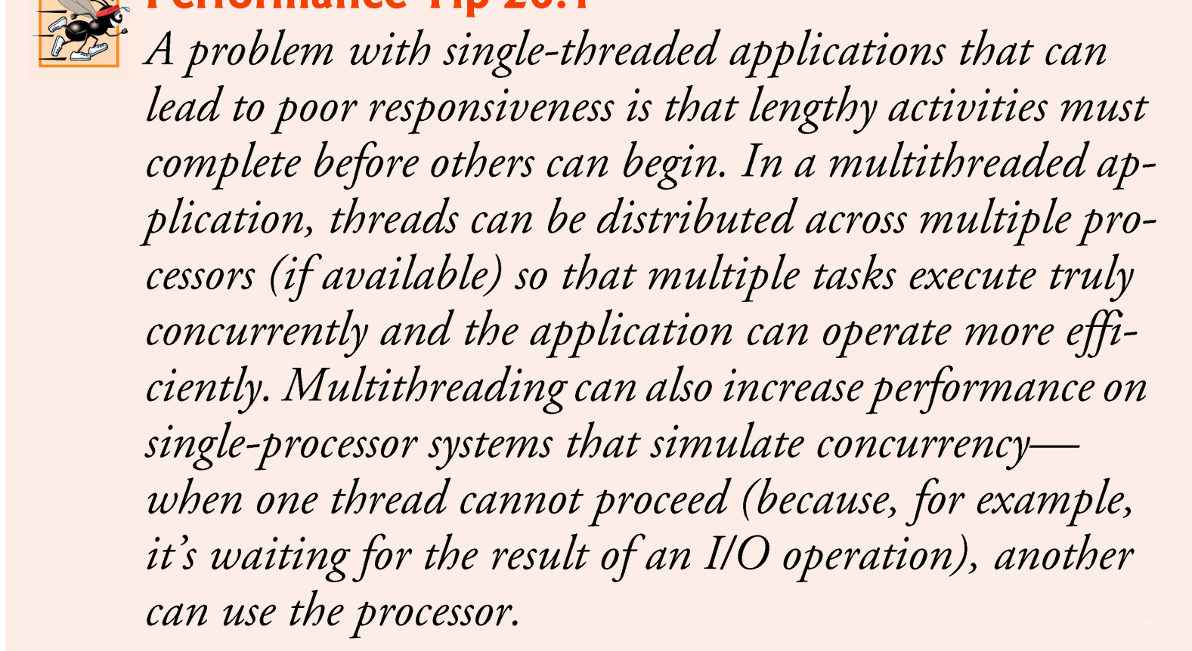
Single –threaded applications

Slide 18
Thread Synchronization
When multiple threads share an object and it is modified by one or more of them, indeterminate results may occur unless access to the shared object is managed properly.
The problem can be solved by giving only one thread at a time exclusive access to code that manipulates the shared object.
  During that time, other threads desiring to manipulate the object are kept waiting.
  When the thread with exclusive access to the object finishes manipulating it, one of the threads that was waiting is allowed to proceed.
This process, called thread synchronization, coordinates access to shared data by multiple concurrent threads.
  Ensures that each thread accessing a shared object excludes all other threads from doing so simultaneously—this is called mutual exclusion.

Slide 19
Thread Synchronization (cont.)
A common way to perform synchronization is to use Java’s built-in monitors.
  Every object has a monitor and a monitor lock (or intrinsic lock).
  Can be held by a maximum of only one thread at any time.
  A thread must acquire the lock before proceeding with the operation.
  Other threads attempting to perform an operation that requires the same lock will be blocked.
To specify that a thread must hold a monitor lock to execute a block of code, the code should be placed in a synchronized statement.
  Said to be guarded by the monitor lock

Slide 20
Thread Synchronization (cont.)
The synchronized statements are declared using the synchronized keyword:
    synchronized ( object )
    {
    statements
    } // end synchronized statement
where object is the object whose monitor lock will be acquired
  object is normally this if it’s the object in which the synchronized statement appears.
When a synchronized statement finishes executing, the object’s monitor lock is released.
Java also allows synchronized methods.

